Slide 1


Plant Disease Detection
Team Members:
Varshitha Yanamala
Sanghavi Yelmelwar
Upendra Madaraboena
Reddy Sai Reddy Duggireddy

Slide 2
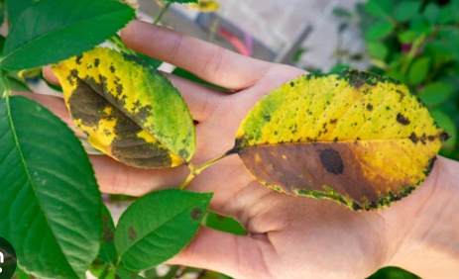
Introduction
Purpose: Leverage big data tools to improve early detection and classification of plant diseases.
Problem: Crop losses due to plant diseases, coupled with challenges in handling large datasets, hinder timely intervention and management.
Proposed Solution:
Develop a machine learning model to classify 88 plant disease classes.
Utilize big data tools like MongoDB and Apache Spark for efficient data storage and processing.
Implement data augmentation techniques to address class imbalance and enhance model accuracy.
Goal: Achieve faster, more accurate plant disease classification to support sustainable agriculture and food security.

Slide 3
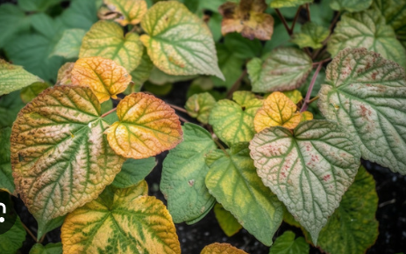
Project Objectives
To design a model that accurately classifies plant diseases across 88 categories.
To manage and process large volumes of plant image data using big data platforms like MongoDB and Apache Spark.
To significantly improve the speed and efficiency of disease detection compared to traditional manual methods.
To enhance the reliability of disease predictions by addressing class imbalances using data augmentation and advanced machine learning techniques.
To provide a scalable solution that can be expanded for other agricultural applications and crop types.

Slide 4
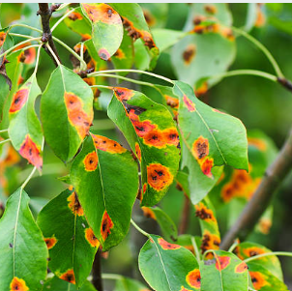
Data Sources and Collection
01
Dataset Description: Over 76,000 images across 88 classes, sourced from 14 repositories.
02
Data Characteristics: Includes diverse environmental conditions (lighting, angles).
Challenges:
Handling large data volumes (17.6 GB).
Removing non-relevant classes and low-quality images.
03
04
Source: Kaggle’s Plant Disease Classification Merged Dataset.
link: https://www.kaggle.com/datasets/alinedobrovsky/plant-disease-classification-merged-dataset?select=Cherry__powdery_mildew

Slide 5
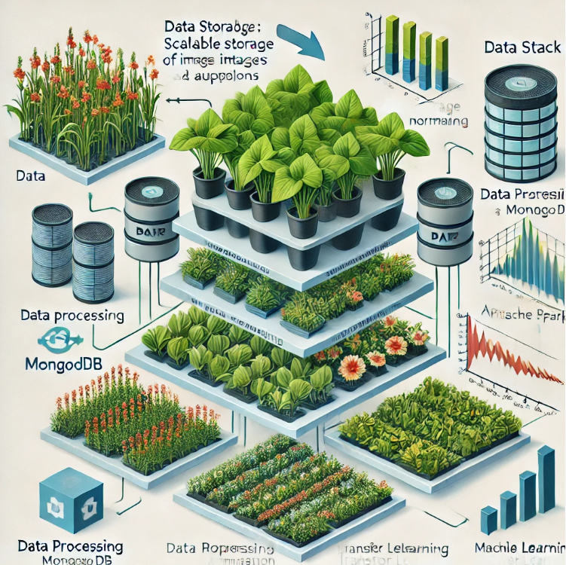
Tools and Technologies
(Python) Jupyter Notebook:is an open-source web application that allows users to create and share documents.
MongoDB: NoSQL database for flexible, scalable storage of image and metadata.
Apache Spark: In-memory data processing for fast, distributed data handling.
CNN Model

Slide 6
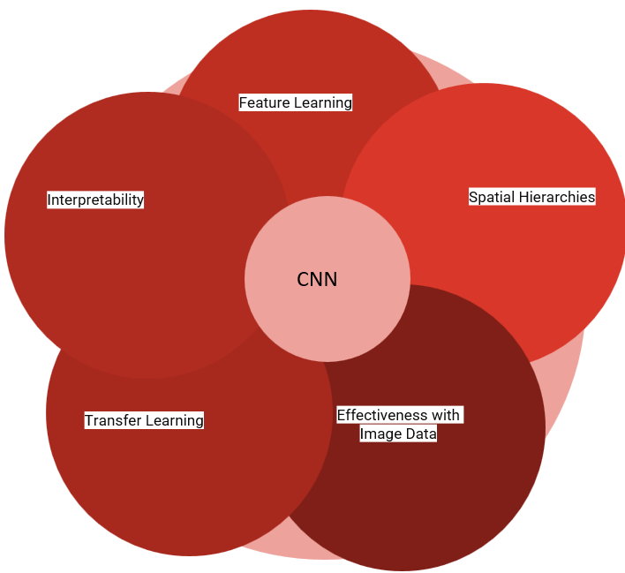
CNN Algorithm
A Convolutional Neural Network (CNN) is a type of deep learning algorithm that is particularly well-suited for image recognition and processing tasks. It is made up of multiple layers, including convolutional layers, pooling layers, and fully connected layers. The architecture of CNNs is inspired by the visual processing in the human brain, and they are well-suited for capturing hierarchical patterns and spatial dependencies within images.

Slide 7
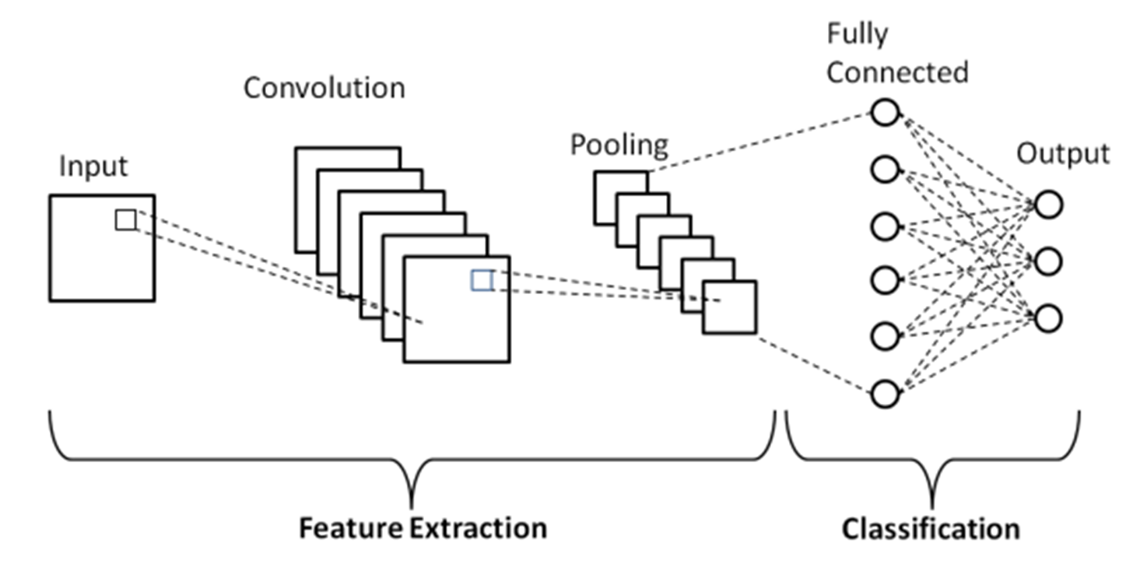
CNN Algorithm

Slide 8
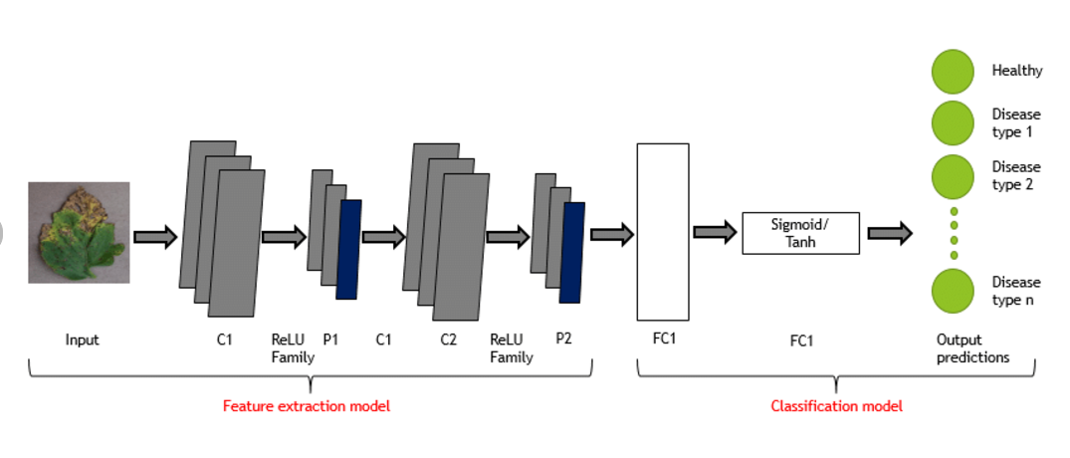
CNN Algorithm

Slide 9
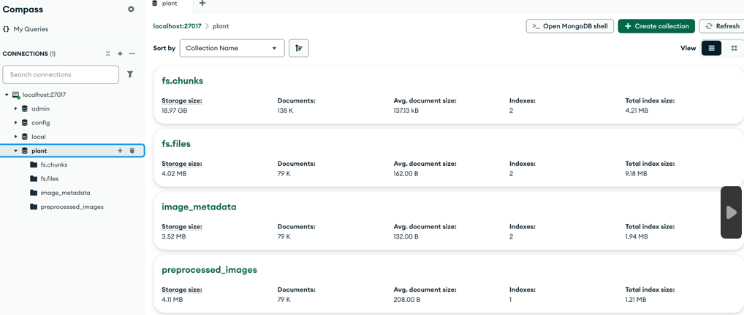
Technical Work

Slide 10
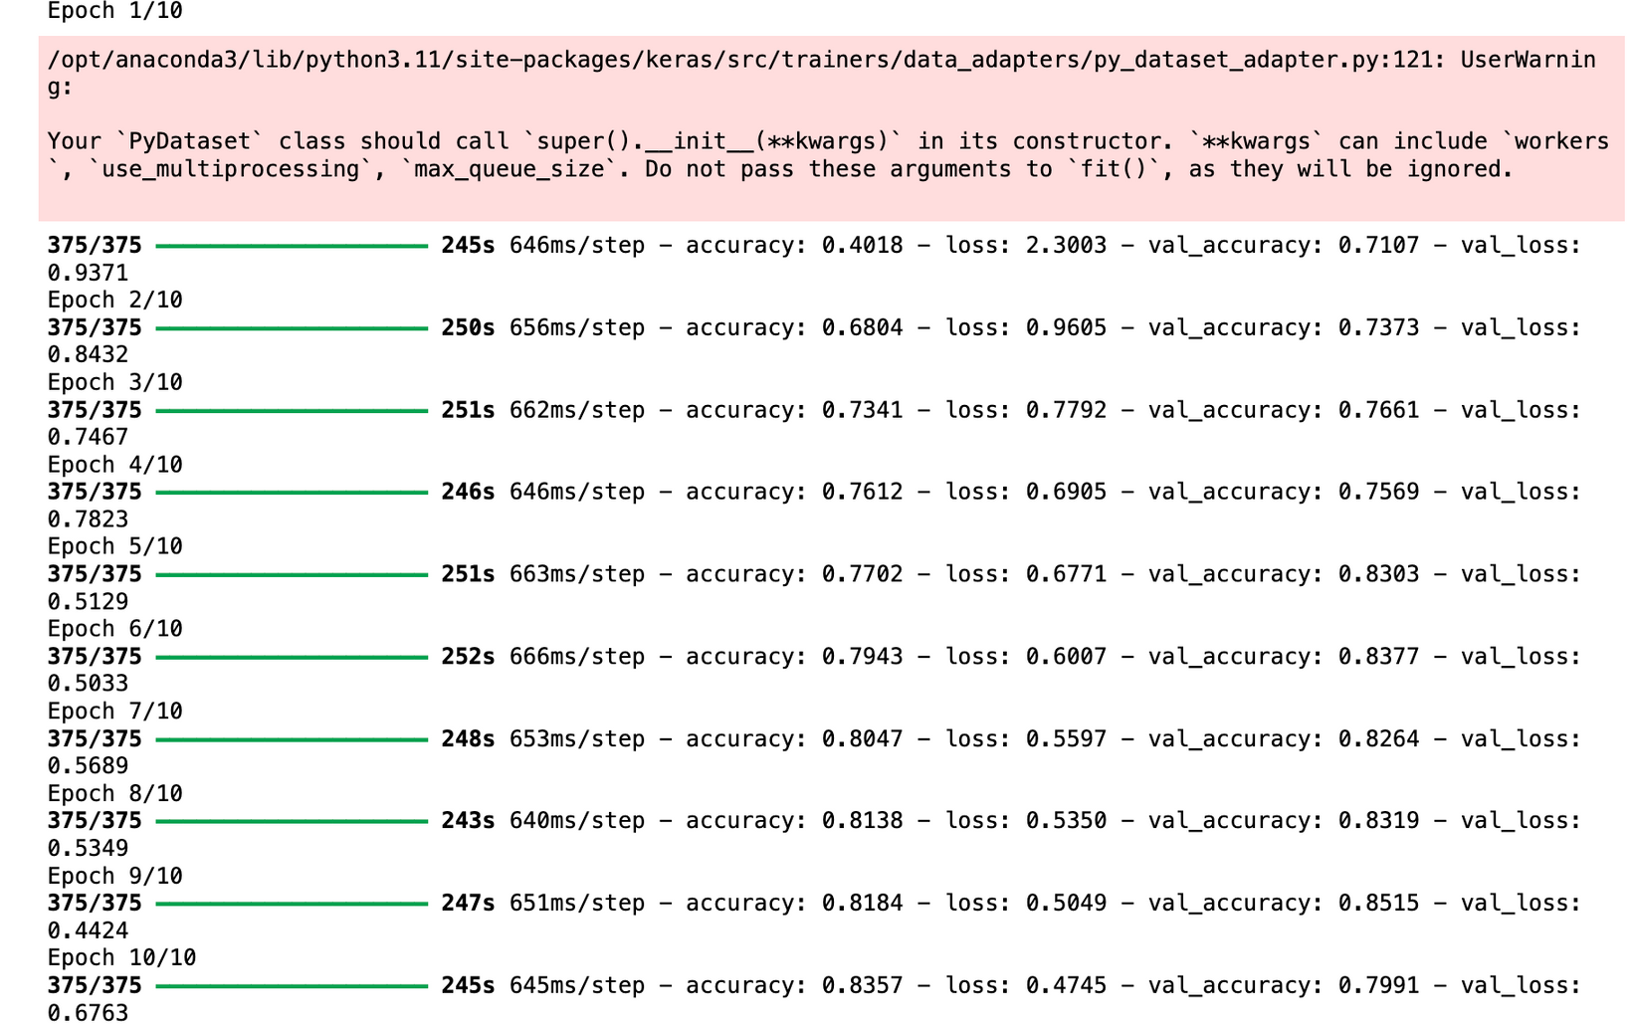
Technical Work

Slide 11
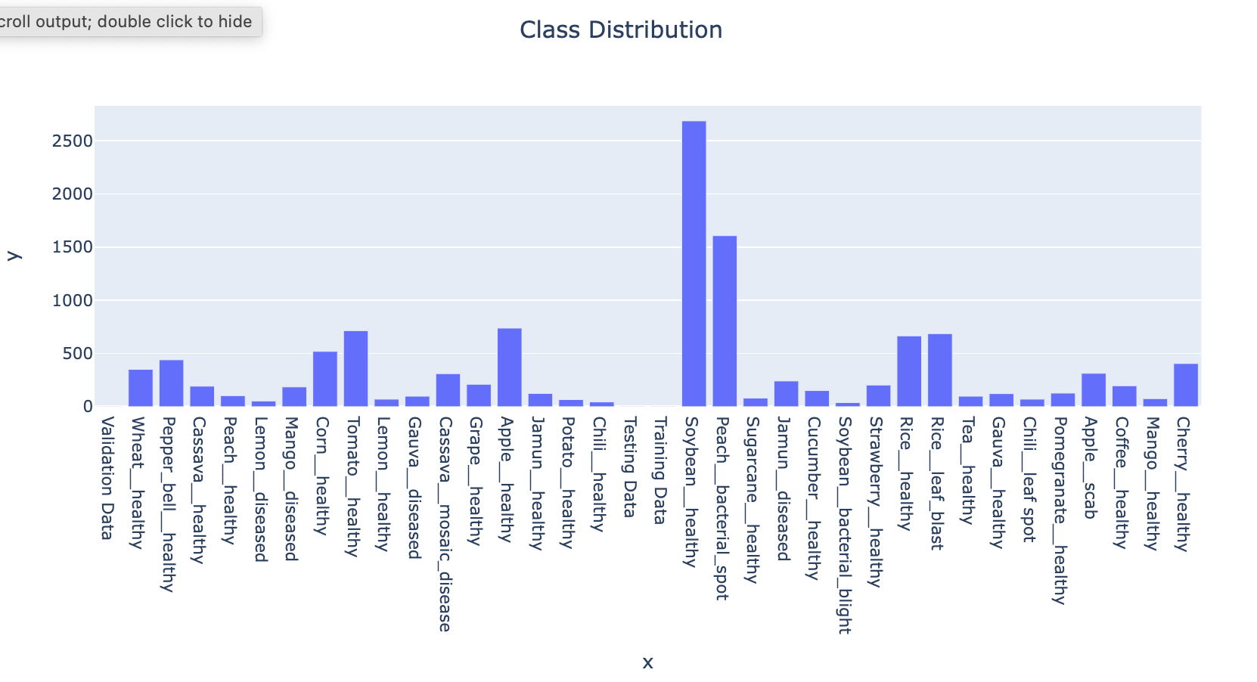
Reports, Insights, and Recommendations

Slide 12
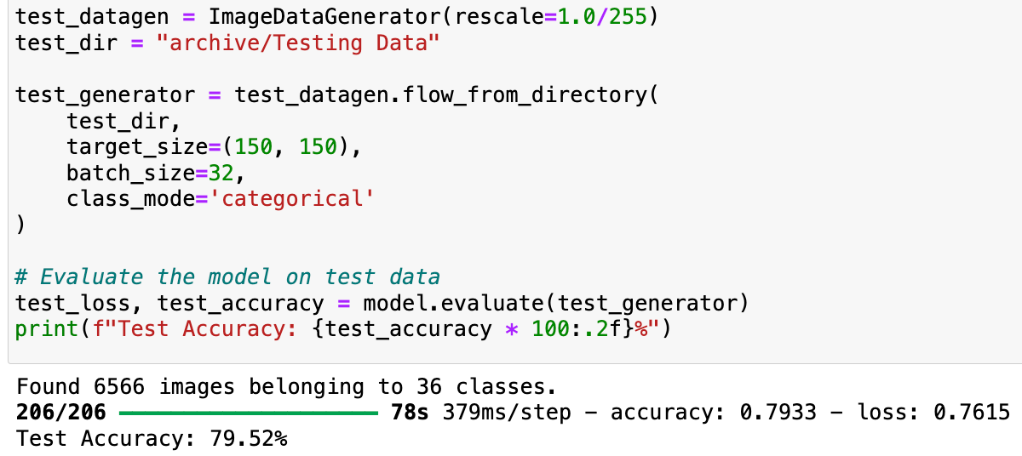
Accuracy achieved:

Slide 13
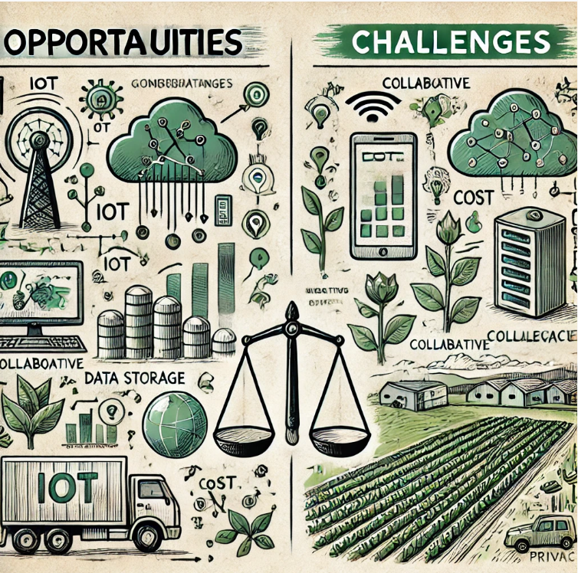
Future Opportunities and Challenges
Opportunities:
Integration with IoT for Real-Time Disease Detection
Generative AI for Synthetic Data Augmentation
Automation in Precision Agriculture
Global Collaboration for Agricultural Data Sharing
Mobile Application Deployment:
Challenges:
Managing Growing Data Storage Needs
Addressing Evolving Plant Diseases
Cost of Technology Adoption for Farmers:
Balancing Data Privacy and Collaboration
Ensuring Generalization Across Geographies

Slide 14
Conclusion:
The project provides a scalable and accurate solution for plant disease detection.
It uses an innovative image recognition system to classify plants with high precision.
Early detection minimizes crop losses and supports timely interventions.
Farmers gain a cost-effective tool to protect crops and improve yields.
Agricultural businesses can make better decisions and increase profits.

Slide 15
References
S. Pawar, S. Shedge, N. Panigrahi, A. P. Jyoti, P. Thorave and S. Sayyad, "Leaf Disease Detection of Multiple Plants Using Deep Learning”.
Doi: https://doi.org/10.1109/COM-IT-CON54601.2022.9850899
D. S. Joseph, P. M. Pawar and K. Chakradeo, "Real-Time Plant Disease Dataset Development and Detection of Plant Disease Using Deep Learning,"
https://doi.org/10.1109/ACCESS.2024.3358333
J. Thirunavukkarasu, K. J. Oindrilla, M. Sangeetha and E. Swetha, "An Efficient Deep Learning Approach for Plant Disease Detection,"
https://doi.org/10.1109/ICSES55317.2022.9914063
X. Liu, W. Min, S. Mei, L. Wang and S. Jiang, "Plant Disease Recognition: A Large-Scale Benchmark Dataset and a Visual Region and Loss Reweighting Approach,"
https://doi.org/10.1109/TIP.2021.3049334
S. Hashemifar and M. Zakeri-Nasrabadi, "Deep Identification of Plant Diseases,"
https://doi.org/10.1109/AISP61396.2024.10475267

Slide 16

Thank You

